Slide 1

Envision
Solve the Sustainability Challenges for the Mankind

Slide 2
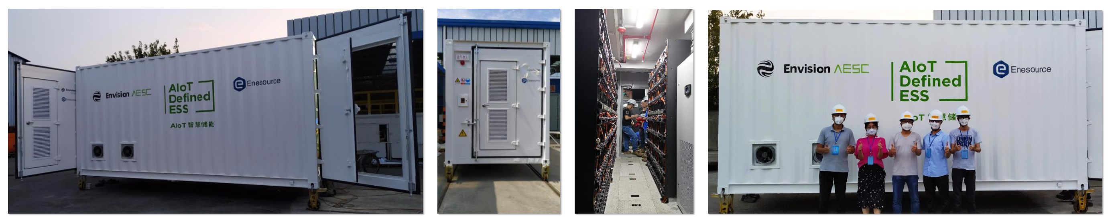



Envision AESC Storage solution: Spécifications
Energie
Cycle de vie ≥ 6,000 cycles
Densité de puissance ≥ 145 Wh/kg
Capacité ≥ 100 Ah
Autre…
IA
EnOS:
AIOT platform
EnOptimizer:
Smart Energy management system
Certifications
IEC 62660-1/-2 (International)
UN 38.3 (International)
UL 1642 (USA, Canada)
GB/T 21484/31485/31486 (China)

Slide 3
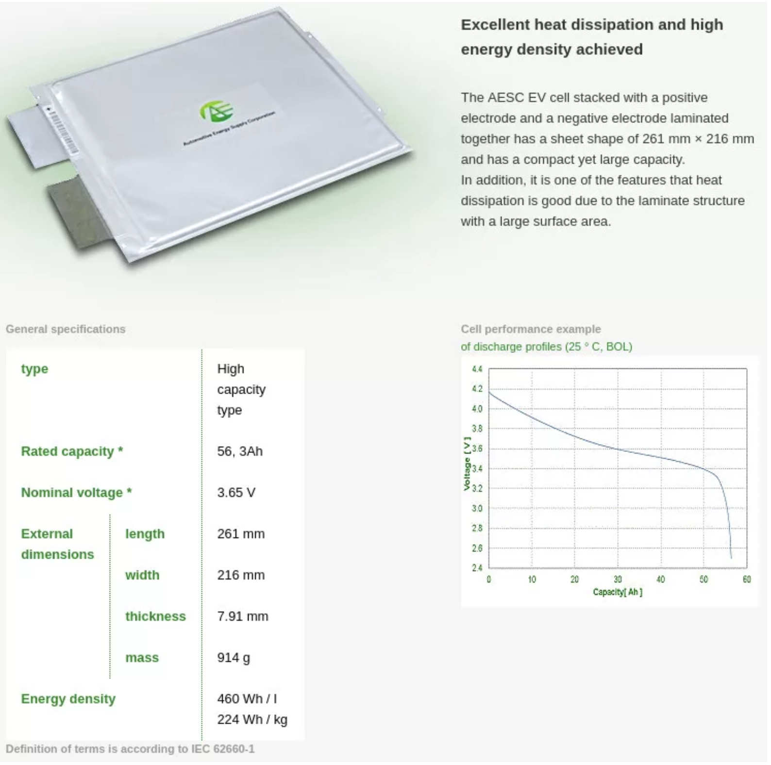

Slide 4
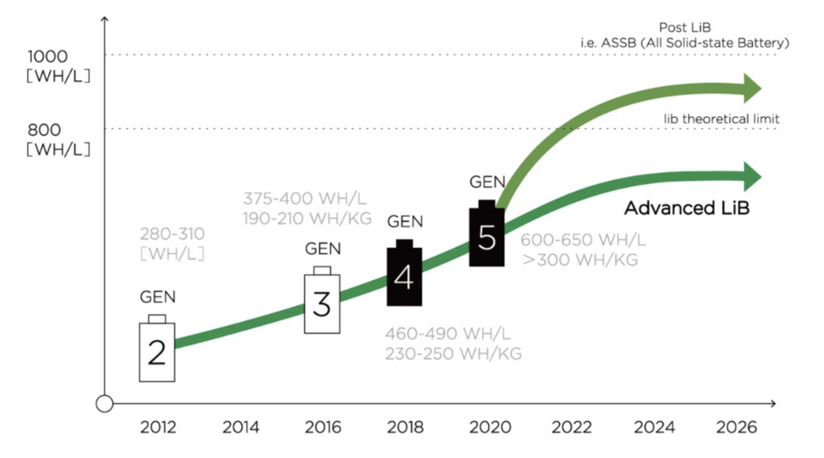

Slide 5
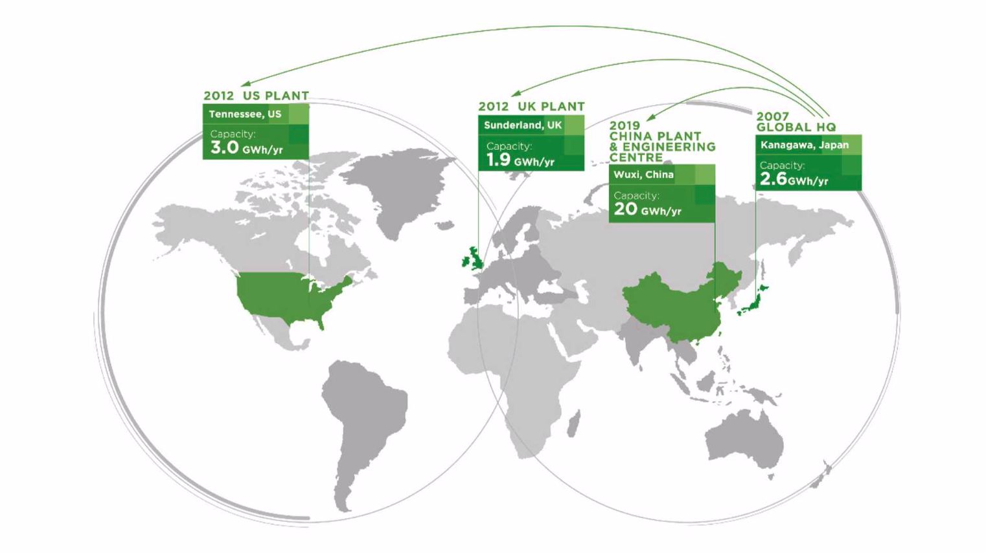
Envision AESC Storage solution: Implémentation

Slide 6
Envision AESC Storage solution: Business Model
HARDWARE
Batterie & Intégration & Installation
250 €/kWh batterie
150 €/kWh intégration
(onduleurs, convertisseurs,
Racks, container)
Maintenance
15 k€/an
SOFTWARE
Application EnOptimizer
5 k€/an
Coûts d’hébergement
3 k€/milliard data/mois
Gestion de projet
1 200 k€/jour

Slide 7
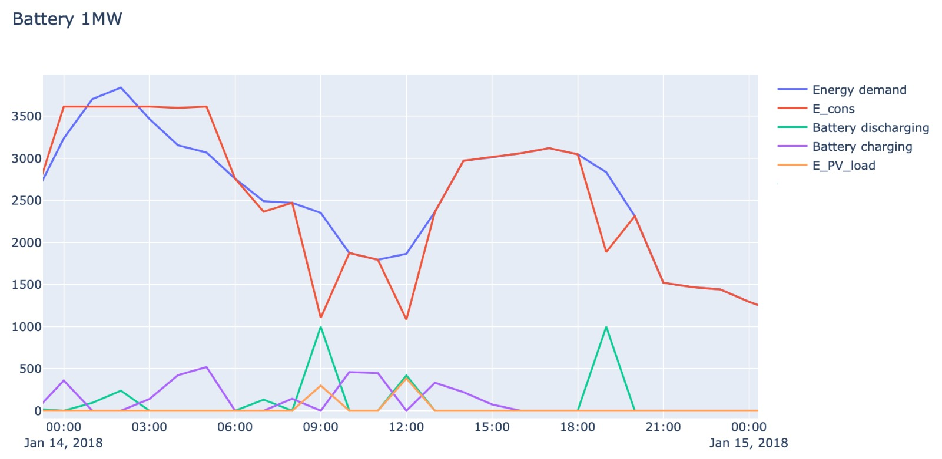
L’application EnOptimizer
Optimisation des flux énergétiques pour une batterie de 1MW
A
Demande énergétique du stade
Achat d’électricité sur le réseau
Charge de la batterie
Décharge de la batterie
Production solaire
A
Effacement du pic de puissance
B
Charge de la batterie en heures creuses
C
Décharge de la batterie en heures de pointe
C
C
B

Slide 8
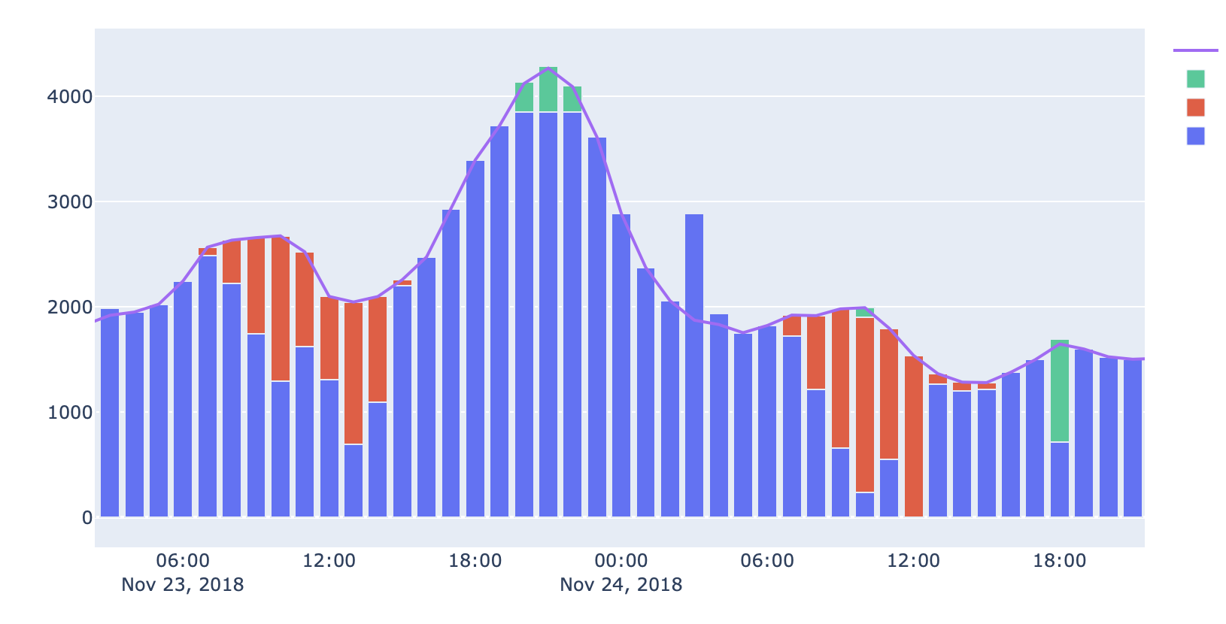
Effacement des pointes
A
Demande énergétique du stade
Décharge de la batterie
Utilisation production solaire
Achat d’électricité sur le réseau
A
Effacement du pic de puissance

Slide 9
Money savings : Battery + EnOptimizer
 | 1 MW | 2 MW | 3 MW | 4 MW
Gains annuels grâce au peak shaving | 19 536 € | 22 428 € | 18 569 € | 18 569 €
Gains annuels grâce au shifting | 11 417 € | 25 504 € | 38 213 € | 48 816 €
Total des gains annuels | 30 953 € | 47 933 € | 56 783 € | 67 385 €
 | 1 MW | 2 MW | 3 MW | 4 MW
CAPEX annuel (sur 10 ans) | 40 000 € | 80 000 € | 120 000 € | 180 000 €
OPEX annuel (hyp de 1milliard de data/mois) | 56 000 € | 56 000 € | 56 000 € | 56 000 €
Coût annuel total de l’installation | 96 000 € | 136 000 € | 176 000 € | 236 000 €
On peut faire tous les graphs qu’on veut, ce n’est pas rentable… Il ne faut pas dissocier l’investissement et les gains solaires des nôtres…

Slide 10
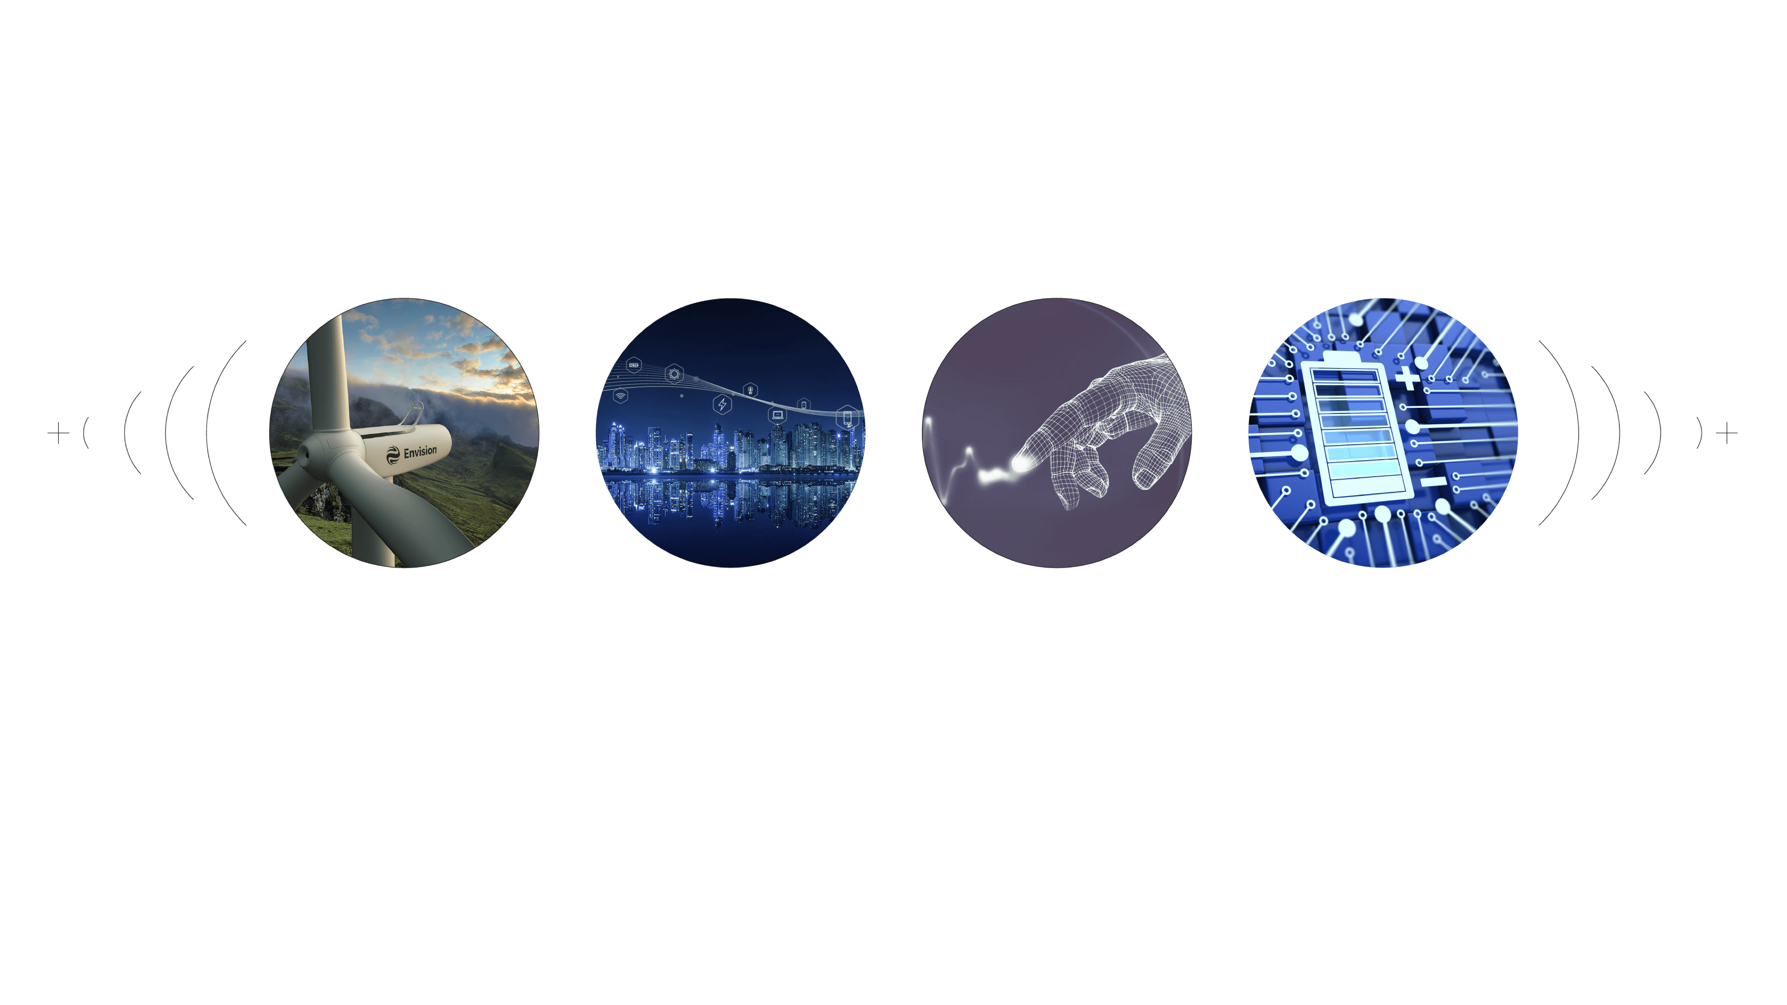
Group Core Businesses
Envision Energy
Envision Digital
Envision AESC
Envision Ventures

Slide 11
Envision Global Footprint
Global Aerodynamic Innovation Center
Colorado, USA
EMEA Office
London, UK
Global Turbine Innovation Center
Silkeborg, Denmark
Envision Digital Bazefield Office
Porsgrunn, Norway
Envision Software R&D Center
Nanjing, China
Envision Digital Hub
Silicon Valley, USA
Envision Group HQ
Shanghai, China
Solar Innovation Center
San Francisco, USA
Digital Wind CoE & US Office
Houston, USA
Global Financing CoE
London, UK
Global Engineering CoE
Hamburg, Germany
Global Digital Hub & R&D Centre
Singapore

Slide 12






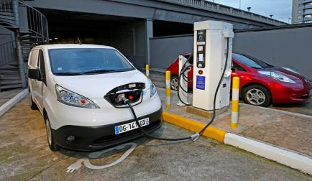


Envision Digital Solution Suite
Intelligent renewable
Digital Plants 4.0
Smart
Building Brain
Smart Mobility
Smart City 2.0
EnOS Cloud
3rd Party Edges
EnOS Edges
3rd Party Edges
Renewable
Grid
Plant
Storage
Building
E-Mobility

Slide 13





EnOSTM Is World’s Largest AIoT OS with 100GW+ Managed Assets
106GW
660K
63Mn
2.2Bn
44Bn
Assets Managed
Device Managed
Sensors
connected
Messages per day
Records
per day
Equal
to UK’s total installed capacity
1.5X
of global installed turbines
Same
as # of iPhone sold in US in 2018
Equal
to # of clicks on “Like” at Facebook
~70%
of # of global messages on WhatsApp

Slide 14

Partner with Singapore Leading Companies to create smart city solutions and products which could be duplicated worldwide
11 April 2018, Envision hosted Singaporean Prime Minister Lee Hsien Loong for Smart Nation talks based on Envision AIoT technology and EnOSTM

Slide 15

EnOS™ will become the underlying OS of Singapore Smart Nation platform
Envision Digital won the tender from Government Technology Agency of Singapore to host and develop the Device Management Control and Data Acquisition System (DECADA)
DECADA will become the common IoT platform for all 104 government agencies
Singapore’s SNSP (Smart Nation Sensor Platform) will be powered entirely by DECADA & ENOSTM

Slide 16
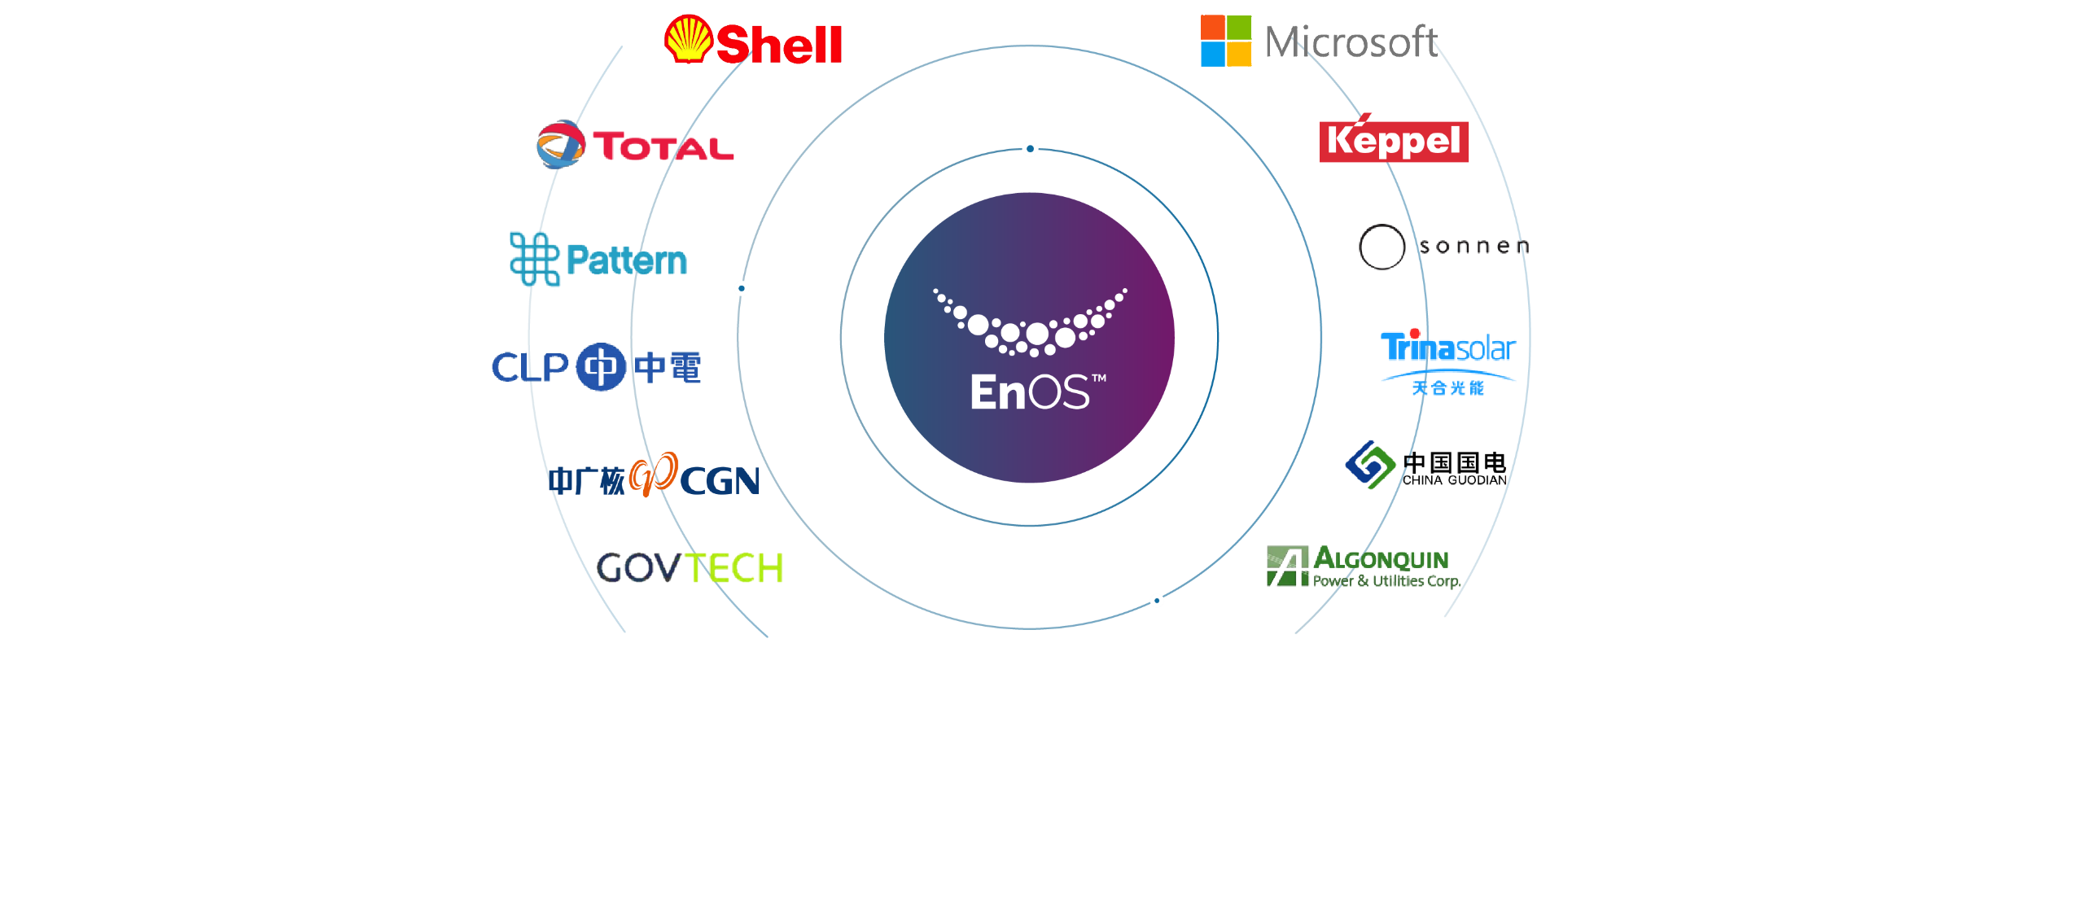
Global Representative Customers

Slide 17
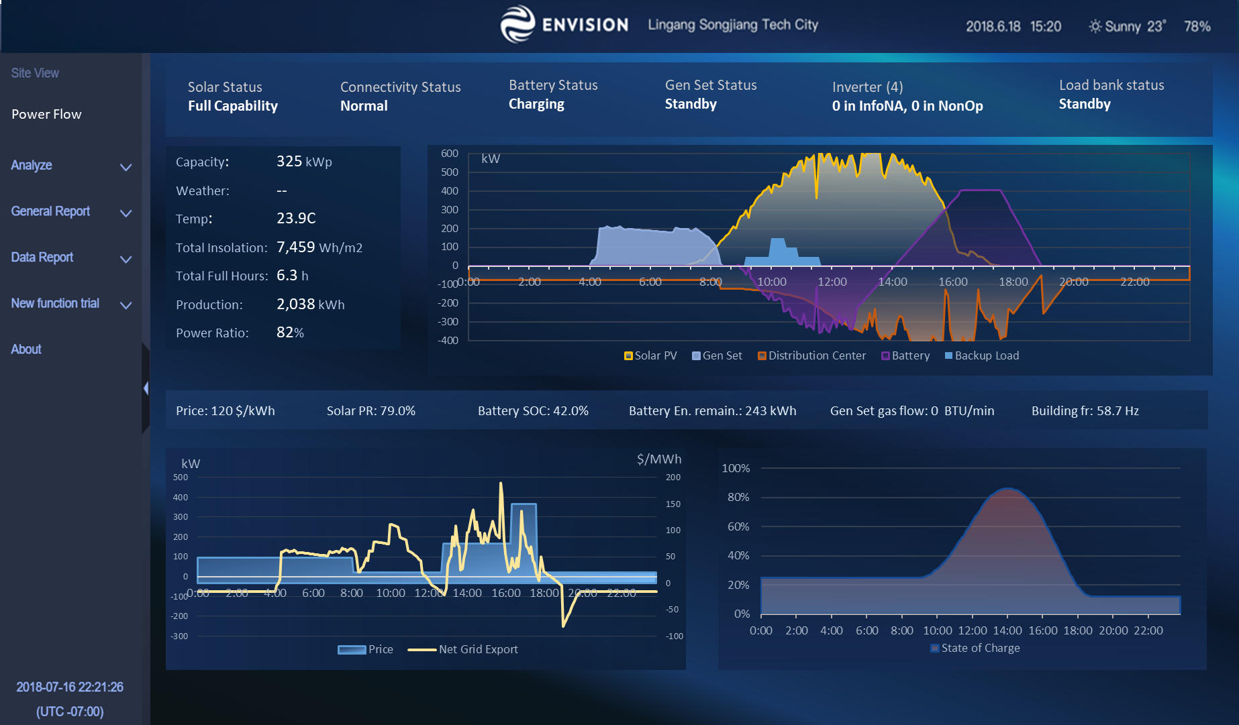
Optimization trough PV + Storage
Self-Consumption + Demand Charge Mitigation
Charging stations introduce demand peaks, impacting rate
Storage + Smart EMS Control reduces these demand peaks
Solar covers self-consumption and contributes to reducing demand peaks
Additional Grid Services Opportunities
Load shifting (for optimal time-of-use)
Load shedding (during flex alerts)
Monetization of Surplus Energy & Capacity
Energy Arbitrage
Demand Response
Flexibility

Slide 18
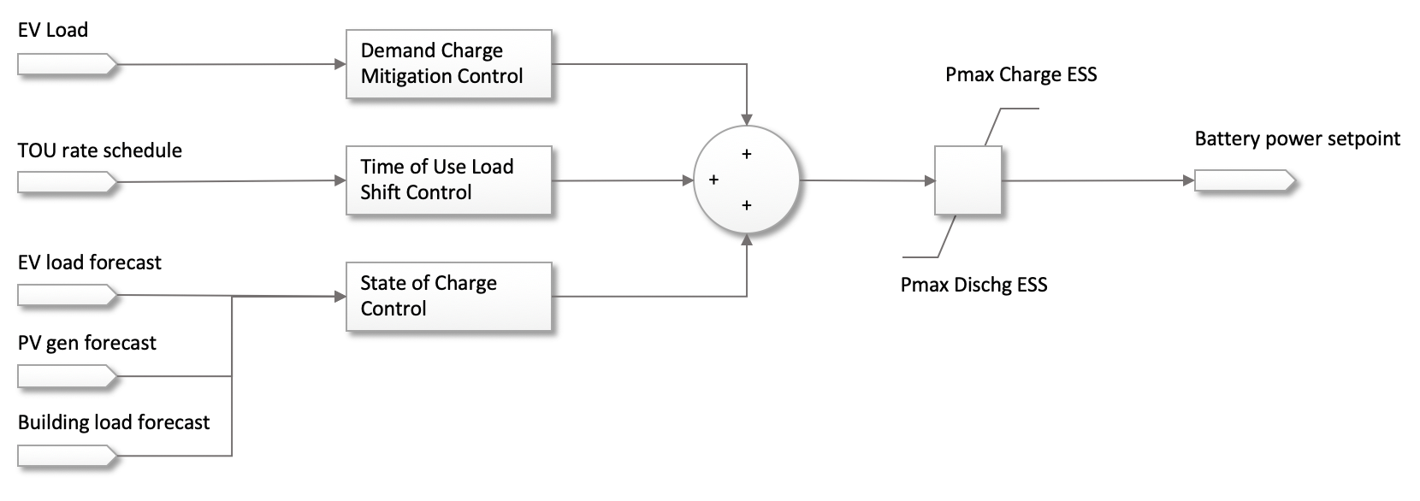
Energy Storage Dispatch Controller
Demand peak mitigation
Load shifting can bring additional revenues
Forecast to help position the state of charge

Slide 19
Energy Storage Dispatch Controller
Demand peak mitigation
Load shifting can bring additional revenues
Forecast to help position the state of charge

Slide 20

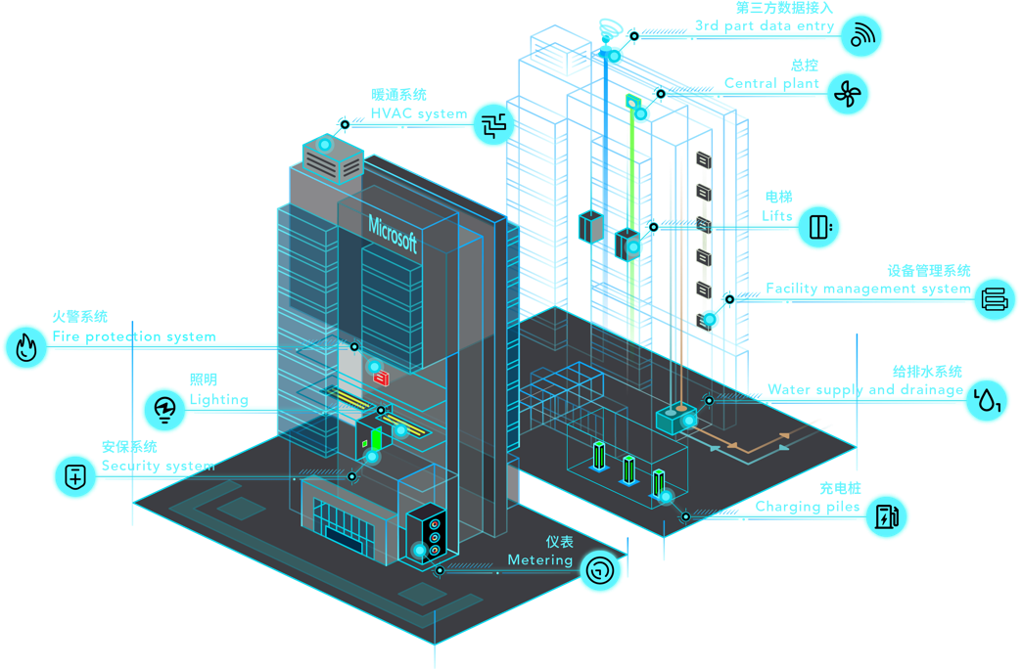




Case Study: Microsoft Smart Building & Facility Management
Provide Best Employee Experience with Lower Operation Cost
10,000+ Sensors
Fast and easy connection for more than 30 different types and brands of smart devices and sensors.
Energy Cost Saving
1.1 MWh Envision Storage system installed to move peak hour energy consumption to off-peak hours.
60+ Additional Charging Piles
Additional charging piles supported by storage system, without large CAPEX upgrading grid capacity.
Data Visualization
Using integrated 3rd party tools for data visualization, helps property managers to figure out defects at one glance.
Space Optimization
Better monitoring the usage of working and parking spaces, improves desk sharing ratio and parking lots management.

Slide 21
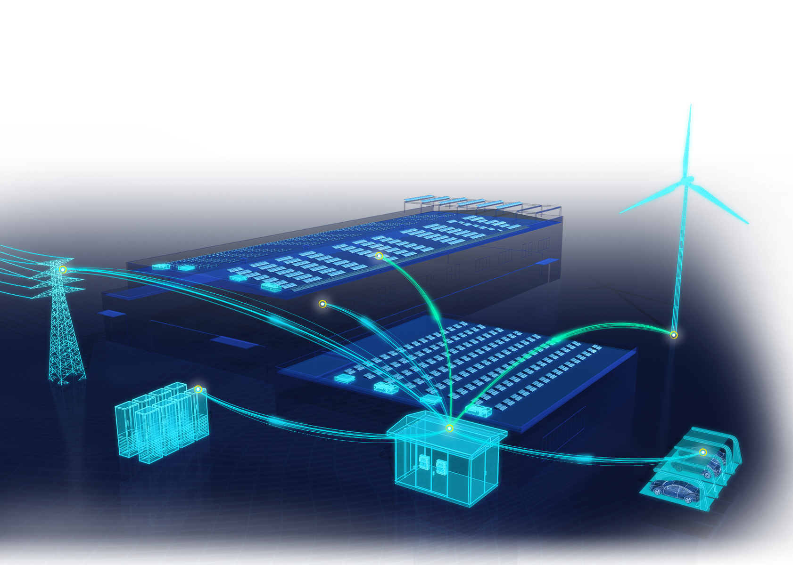
Envision’s Green Jiangyin Industrial Park
Wind
Capacity
4700
kW
Power
3730
kW
Solar
3916
100
Capacity
230
kW
Power
186
kW
kW
%
Storage
300
150
Renewable
output
Renewable penetration
Capacity
kWh
kW
Power
41
kW
SOC
63%
Wind
3730
EV Charger
kW
Charging Power
315
kW
Solar
186
Discharge Power
0
kW
kW
Transformer
SOC
125/300
kWh
Load
1529
Capacity
2500
kW
kVA
Electricity Cost
0.65
￥/kWh
Annual Consumption
7.13m
kWh

Slide 22
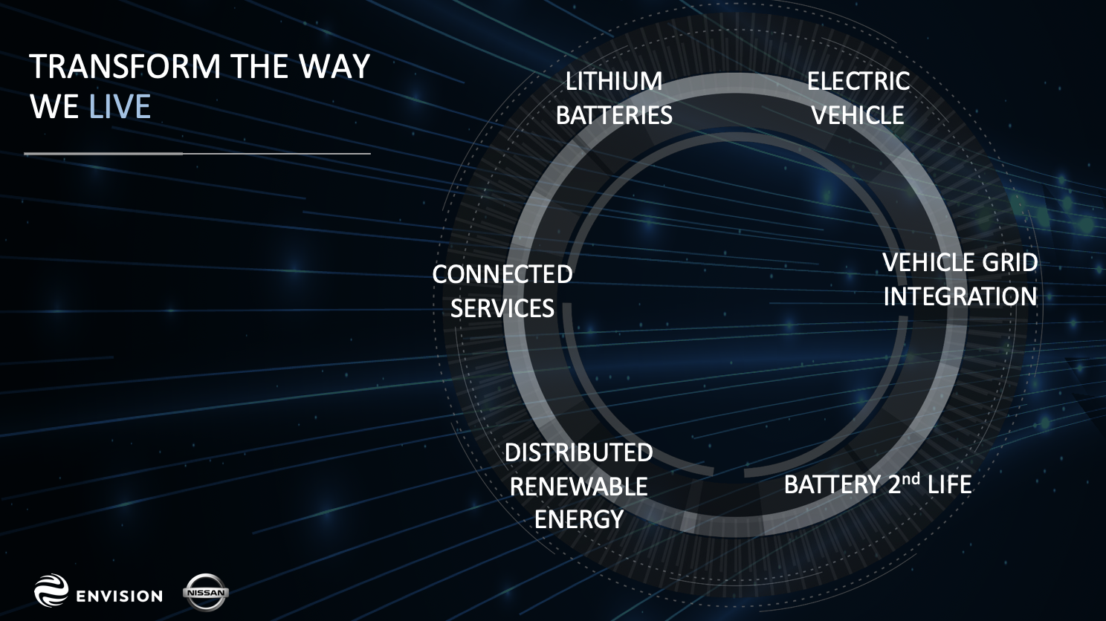

Slide 23
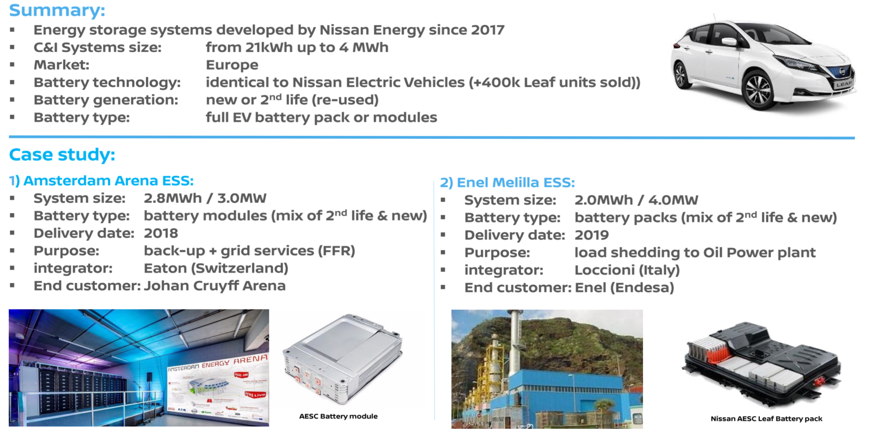


Slide 24

AIoT enhances Formula E race performance, and helps win the race against climate change
AI and IoT technologies help optimize energy management throughout the race, enhancing race performance on track
Envision Virgin Racing team shares the aspiration to accelerate the energy transition, where everyone has access to clean, secure and affordable energy

Slide 25
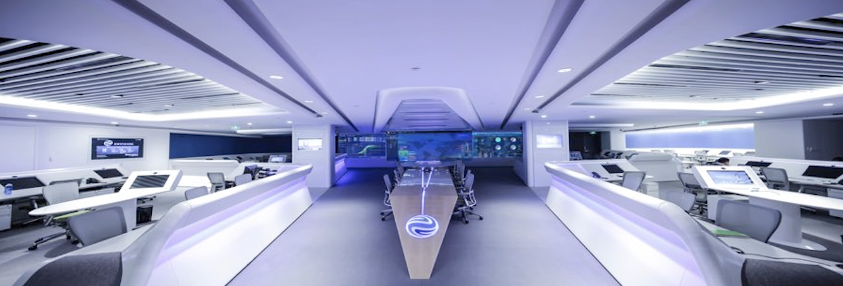
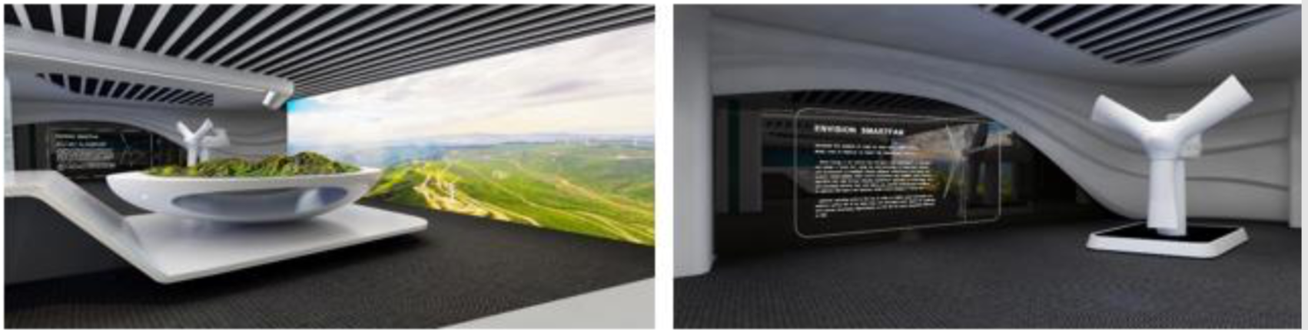
Invitation to Visit Cloud Centre

Slide 26


